Slide 1
Governance and quality of software code Auditing of free and open-source software An updated Inventory for the FOSS used within the European Commission*
EU-FOSSA 2
May 2020
* On data snapshot of December 2018

Slide 2
Counting and Screening FOSS
Free and Open Source Software items in use at the European Commission and managed by DIGIT amount to a significant part of the total software items (4.347 out of 10.198)
The number of instances of FOSS amounts up to 6.159.625 on a total of 41.743.019
As depicted on the graph above, 15% of all software items installed and inventoried is Free and Open Source Software

Slide 3




Business criticality analysis
FOSS LIST
Software Name* | Number of instances
Java{TM} Platform SE binary | 42877
Firefox | 42449
VLC | 39711
7-zip | 37444
Perl | 34192
Info-ZIP | 23956
qt | 22090
Calibre | 20153
nspr & nss | 18722
OpenSSL & pyOpenSSL | 18032
glibc | 17329
XULRUNNER | 16529
Gecko SDK | 16523
libstdc++ | 16073
Notepad++ | 14263
Python | 14206
libXau | 14171
bzip2 | 12115
Linux kernel | 11791
rpm | 9795
Relation
with security
Number of
instances
Exposure
to end user
Criticality
Index (CI)
OSS LIST
RANKED BY CRITICALITY
ANALYSIS AND RANKING
Dark grey entries indicate software names appearing for the first time

Slide 4
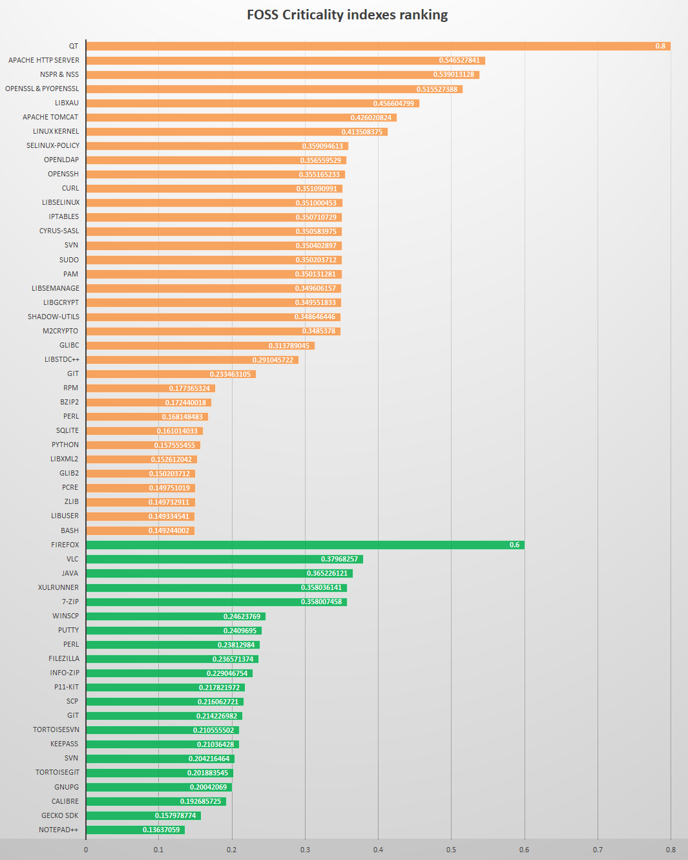
The critical software shortlist
For each analysed environment:
Note: Java is not fully open source software; only source code of some libraries is available, based on a non-OSS compatible license.
The top business critical items are sorted into a
shortlist
The vulnerabilities of the highest ranked items would impact the most due to their spread and use within the European Commission.
Servers
AppV & Workstations
Partial list shown here

Slide 5
Business criticality analysis - Nexus
FOSS LIST
Software Name | Number of Instances
slf4j-api | 1672
commons-logging | 1270
commons-lang | 1248
commons-io | 1134
commons-collections | 1101
log4j | 1051
spring-core | 1040
commons-lang3 | 922
jcl-over-slf4j | 879
commons-codec | 863
activation | 770
guava | 733
javassist | 719
validation-api | 700
aopalliance | 691
jackson-core | 680
joda-time | 673
jackson-databind | 670
commons-beanutils | 654
dom4j | 638
Relation
with security
Number of
instances
Exposure
to end user
Criticality
Index (CI)
OSS LIST
RANKED BY CRITICALITY
ANALYSIS AND RANKING

Slide 6
Critical software shortlist - Nexus
The top business critical items inventoried in Nexus software repository are sorted into a shortlist

Slide 7
Sustainability analysis
The critical FOSS shortlist was assessed on 34 sustainability metrics
(including Community Activity, Performance, Quality and Security, Demographics and Diversity, Governance and FOSS support.)

Slide 8
Sustainability analysis - Nexus

Slide 9
Dependency analysis
Components | Number of dependencies
Python | 21 dependencies
Firefox | 20 dependencies
gtk2 | 19 dependencies
XULRUNNER | 17 dependencies
nfs-utils | 15 dependencies
initscripts | 14 dependencies
VLC | 13 dependencies
rpm | 12 dependencies
autofs | 10 dependencies
subscription-manager | 9 dependencies
Perl | 2 dependencies
The project also analysed the dependencies within the Critical FOSS shortlist. The components shown in the table have more than 1 dependency upon the shortlisted items.
Components | Number of dependant software
Glibc | 205
Bash | 105
Zlib | 42
coreutils | 33
libselinux | 32
libX11 | 30
systemd | 28
Info | 25
openssl-libs | 20
The analysis shows a relative fragmentation of the dependencies, apart from Glibc and Bash, which relate to the software shown in the table.

Slide 10
Project Documents
For more details on the European Commission FOSS inventory, please refer to the project documents published at:
https://joinup.ec.europa.eu/collection/eu-fossa-2/eu-fossa-2-deliverables

